Slide 1
CAPSTONE PROJECT
XYZ CORPORATON LENDING DATA
Submitted By:
Utkarsha Desale
Manish Madhavi
Shalaka Patil
Jyothirmai Palle
Course and Batch: PGA-6 Feb. 2021

Slide 2
OBJECTIVE
The objective of project is to build a data model to predict the probability of default, whether the customer will default the loan or not by using the past data.

Slide 3
INTRODUCTION
Investors (lenders) provide loans to borrowers in exchange with an agreement of repayment with interest.
That means the lender only makes profit (interest) if the borrower pays off the loan. However, if he/she doesn’t repay the loan, then the lender loses money.
XYZ Corp. is looking towards building a model to predict default in the future, which will help them in deciding whether to sanction a loan or not.
So all in all it is like stepping into the shoe of the loan issuer and manage credit risk by using the past data and deciding who to give loan in future.

Slide 4
Data Set Description:
Contains 855969 rows and 73 columns.
The response variable is default_ind as 0 for Non-Default and 1 for Default.

Slide 5
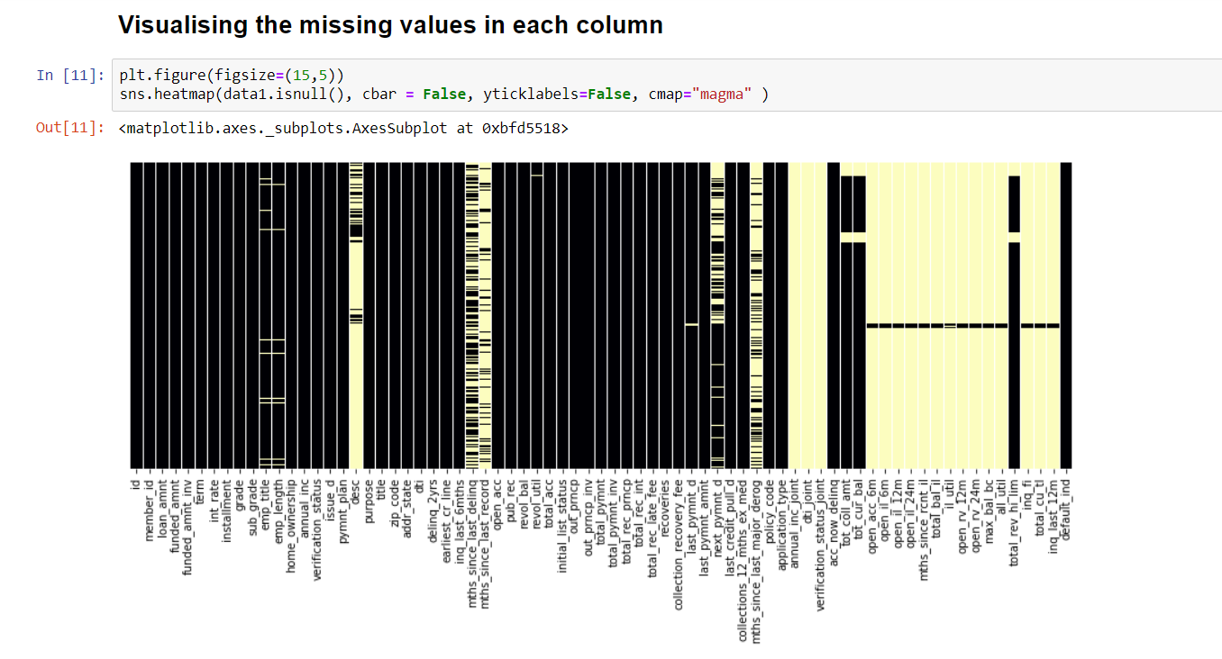
Data Extraction and Cleaning MISSING VALUES ANALYSIS The initial step was to check the missing values in each variable and for a better view we plotted a heatmap of the dataset for visualizing the missing values as shown below.

Slide 6
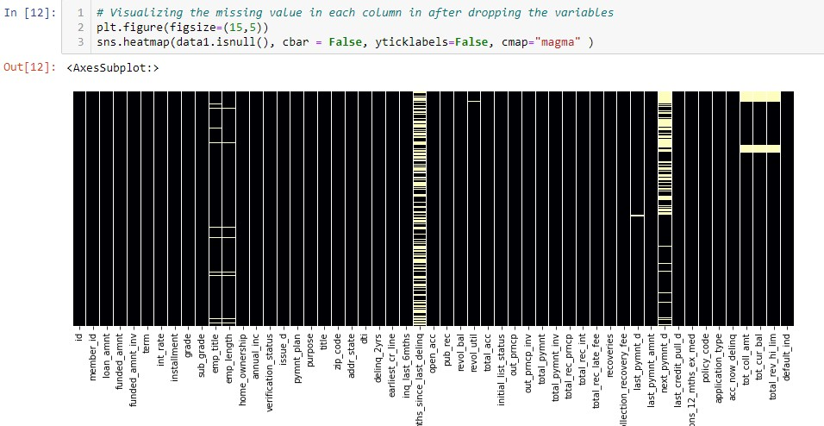
By comparing the above two heatmaps, it is clearly seen that the amount of missing values have been reduced drastically.
Also the dataset does not consists any duplicate records.

Slide 7
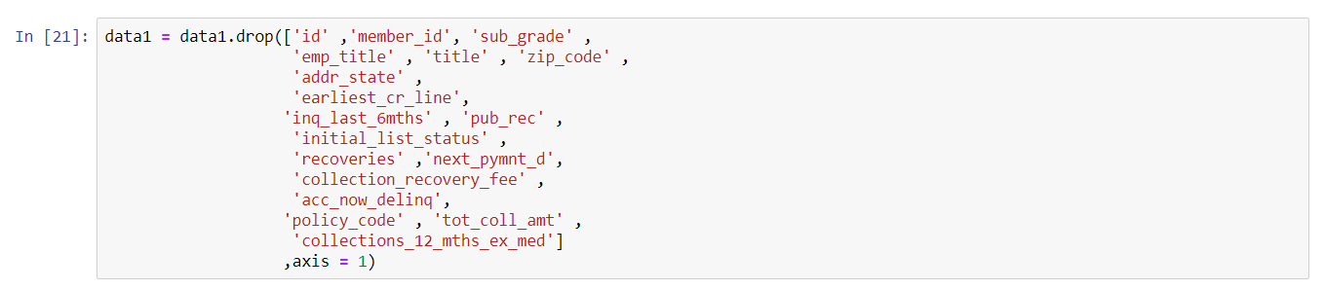
The next step was to drop the following irrelevant variables with proper reasoning
id and member_id ==> id and member_id are all unique which is a bit misleading. So every record is a unique customer
application_type ==> application_type is 'INDIVIDUAL' having 855527 records which is 99.94% of the records
acc_now_delinq ==> acc_now_delinq is 0 having 852039 records which is 99.5% of the records
emp_title ==> emp_title not needed here
zip_code ==> zip_code not needed for this level of analysis
title ==> title variable because it's a categorical varibale with (60991 level)
earliest_cr_line ==> earliest_cr_line variable because it's a date varibale with (697 level)
next_pymnt_d ==> as per the domain knowledge it is also not imp variable
other few variables we deleted according to domain knowledge

Slide 8
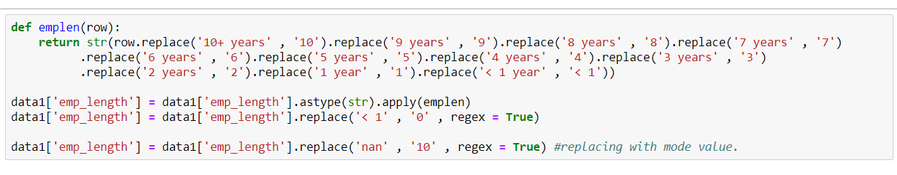
Variable Transformation
Here we have extracted numbers from emp_length.
If emp_length==10+ years then we leave it as 10 & similarly for other observations too.

Slide 9
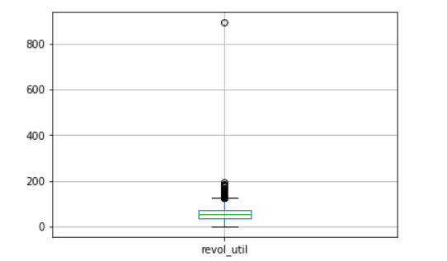
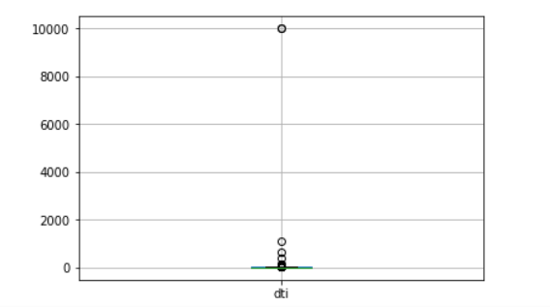
Detecting the Outliers
Here we generated the Boxplot for all the numeric variables where we found that two variables revol_util , dti have single observations that are too far away from the remaining data.
revol_util has only one value above 193 and that is 892 and dti has only one value above 1093 which is 9999. So, we removed those 2 observations.
The remaining missing values present are treated by using Mean and Mode.

Slide 10
Imputing Missing values
Missing values treatment with Mean
The missing values of the following variables are treated with mean
tot_cur_bal
total_rev_hi_lim
revol_util
mths_since_last_delinq
While the missing values of the following variables are treated with Mode
emp_length
And the missing values of following variables are treated by ffill() function
last_pymnt_d
last_credit_pull_d

Slide 11
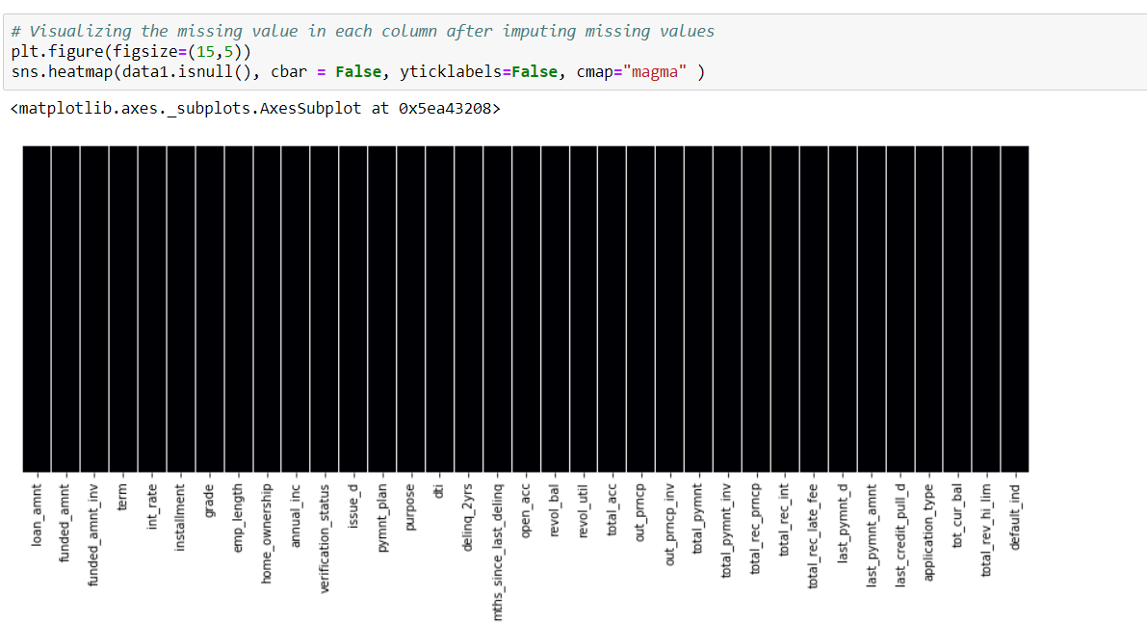
After the complete treatment of the missing values, it is evident from the below heatmap that the dataset is now clean.

Slide 12
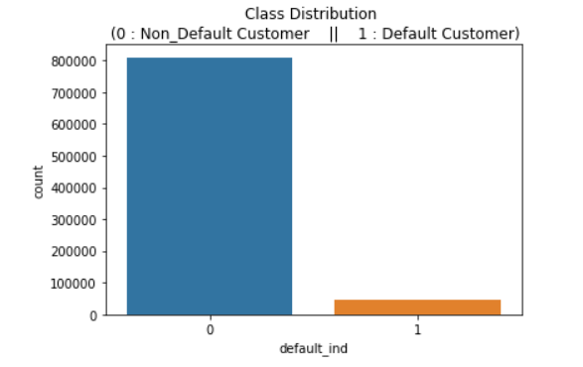
Data Visualization
Data Visualization for Categorical Variables
Plot showing the count of the Default customers and Non-default customers in
‘default_ind’ variable.
Non-Default Customer: 94.57 % of the dataset.
Default Customer: 5.43 % of the dataset
From the above graph, we gain that the dataset is highly unbalanced.

Slide 13
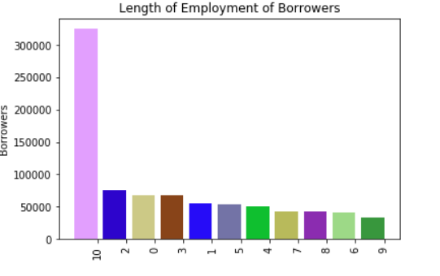
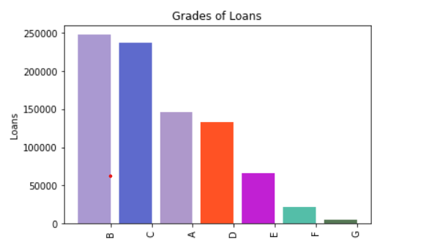
Plot showing the distribution of ‘length of
employment of borrowers’ variable
Plot showing the distribution of ‘Grades of loans’ variable

Slide 14
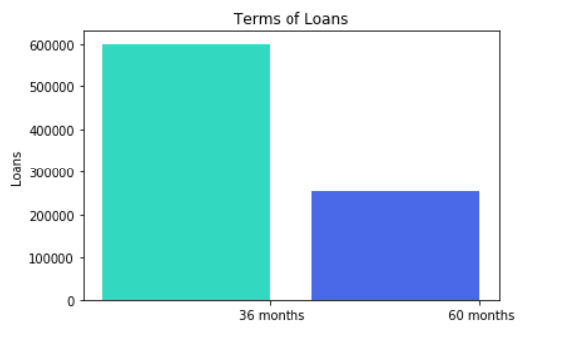
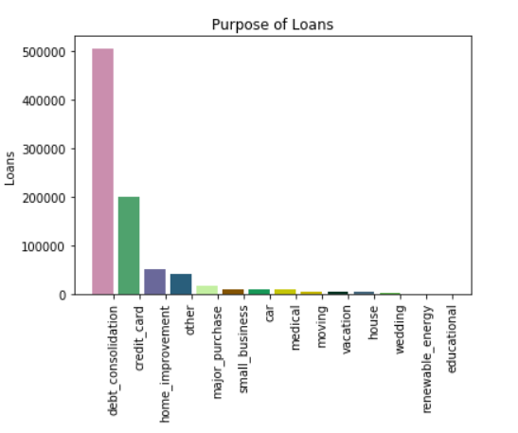
Plot showing the distribution of
‘Term of loans’ variable
Plot showing the distribution of
‘Purpose of loans’ variable

Slide 15
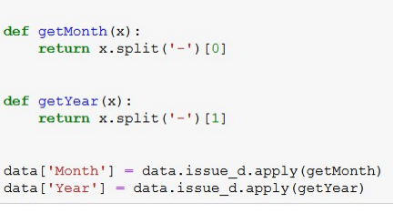
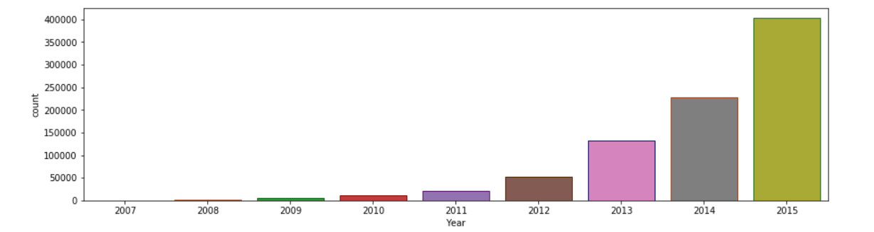
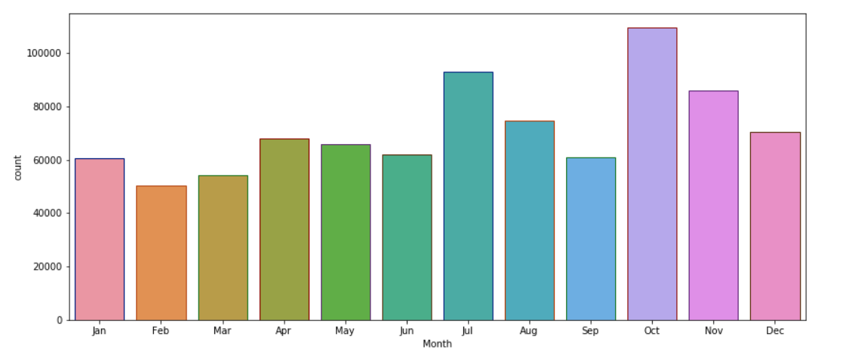
A function is created that will split the ‘issue_d’ variable which is nothing but the year & month in which the loan was funded.
Plot showing the distribution of ‘Exponential rise in the num. of applications over a period of year’ variable
Plot showing the distribution of ‘Exponential rise in the num. of applications over a period of month’ variable

Slide 16
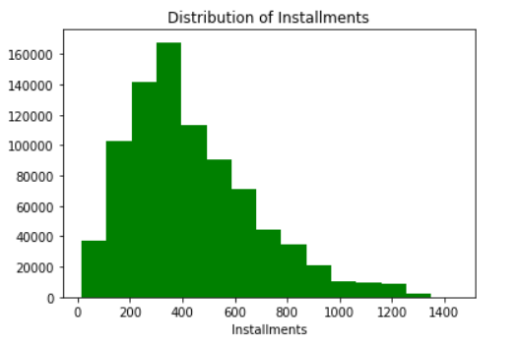
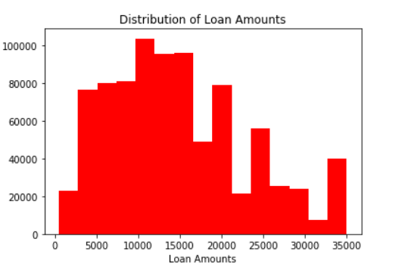
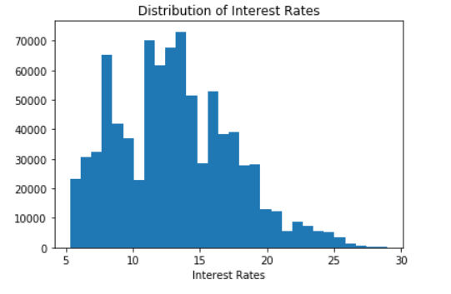
Data Visualization for Numeric Variables
Plot showing the distribution of ‘Instalments’ of variable
Plot showing the distribution of ‘Loan Amounts’ variable
Plot showing the distribution of ‘Interest Rates’ variable

Slide 17
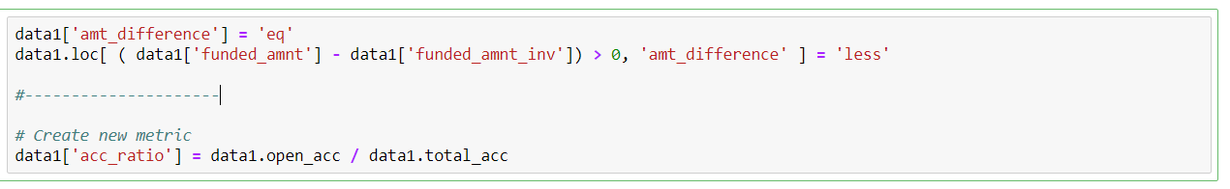
Feature Engineering and Variable Selection
Here we have converted funded_amnt and funded_amnt_inv into a single variable amt_difference similarly we converted open_acc and total_acc into a single variable acc_ratio. Then we removed those 4 variables

Slide 18
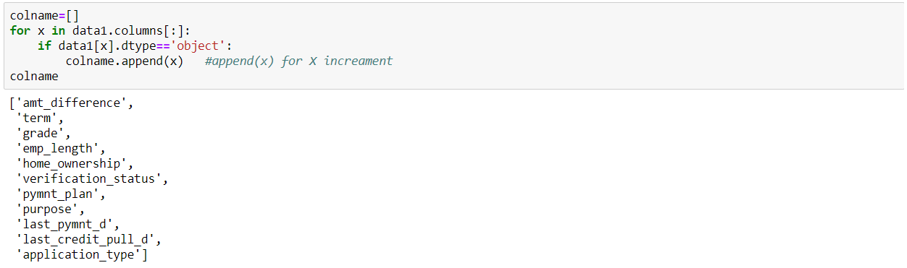
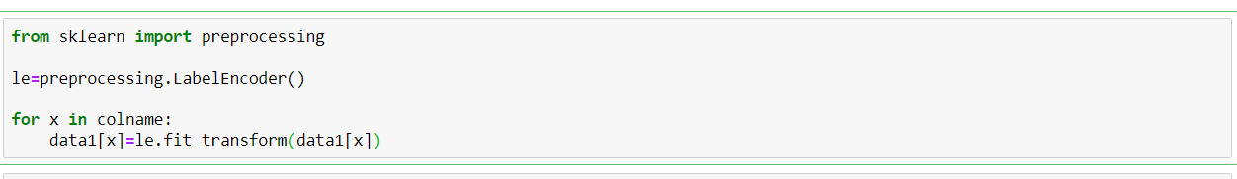
Label Encoding
The above code represents the variables of datatype object. We are converting these variables into numbers using following code.

Slide 19
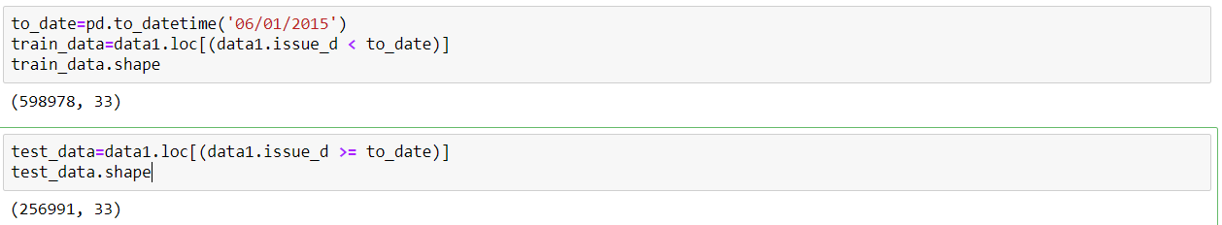
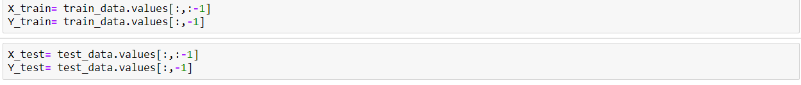
Data Partitioning
We divided te data based on the ‘issue_d’ variable in which the records from June-2007 to May-2015 will go into Training data while the records from June-2015 to Dec-2015 in the Testing data
The following code shows creation of X_train, X_test, Y_train, Y_test

Slide 20
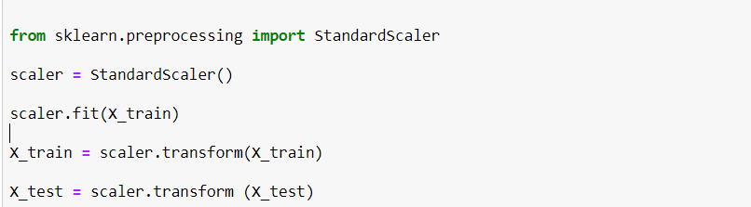
Feature Scaling
We scale the data to avoid bias that can arise from large inconsistency in numerical variables. While Normalization forces to return the values from 0 to 1. Standardization forces to return the values from -3 to 3.
Here we have used standardization method to avoid the effects of outliers.

Slide 21
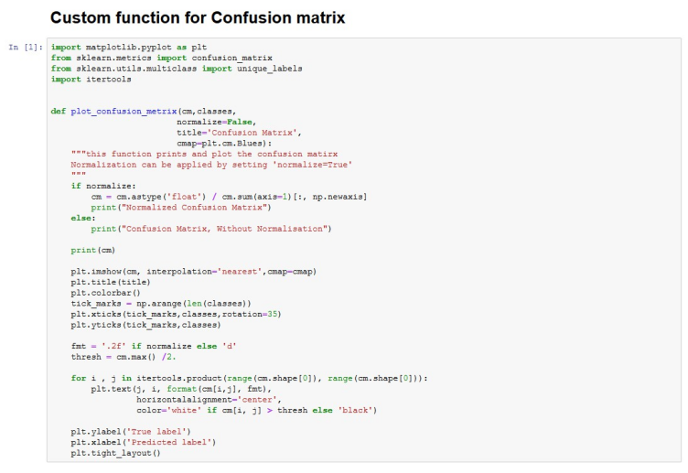
MODEL BUILDING
Here we created a custom function for Confusion Matrix for better understanding and organized look.

Slide 22
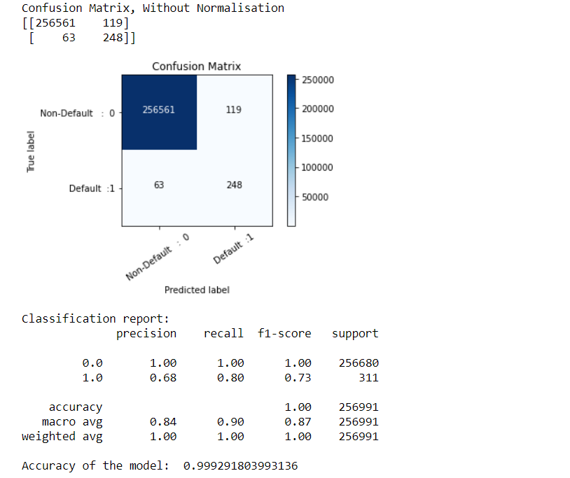
Logistic Regression
From the sklearn.linear_model library using the ‘LogisticRegression’ , we created a logistic regression model and following results were interpreted.

Slide 23
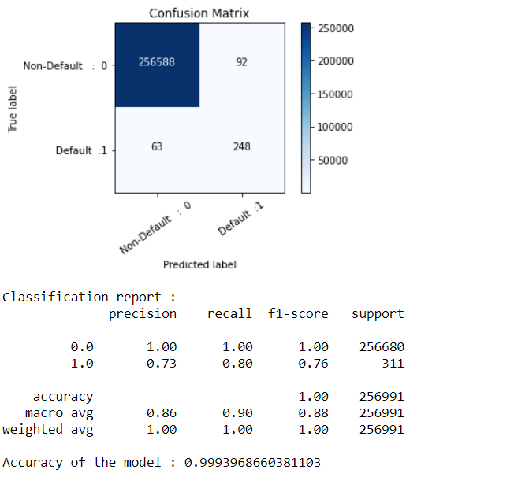
Tuning the Logistic Regression model
Adjusting the threshold level of the probabilities to 0.56

Slide 24
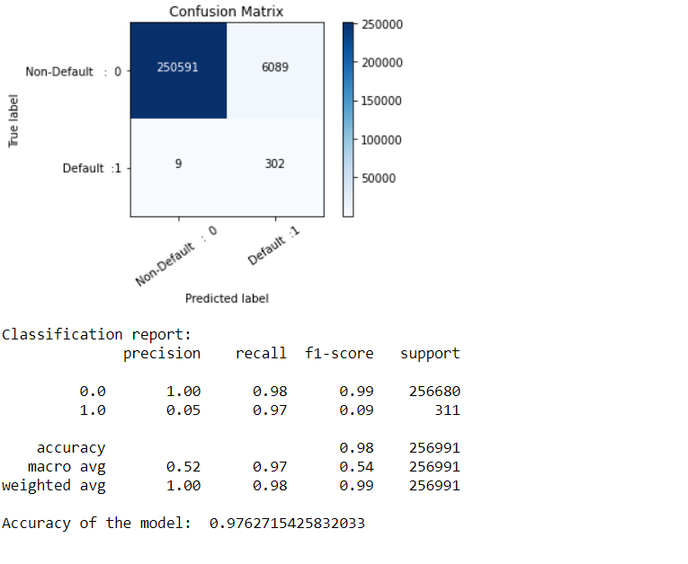
DecisionTreeClassifier
From the sklearn.tree library using the ‘DecisionTreeClassifier’ , we created a DecisionTree model and following results were interpreted

Slide 25
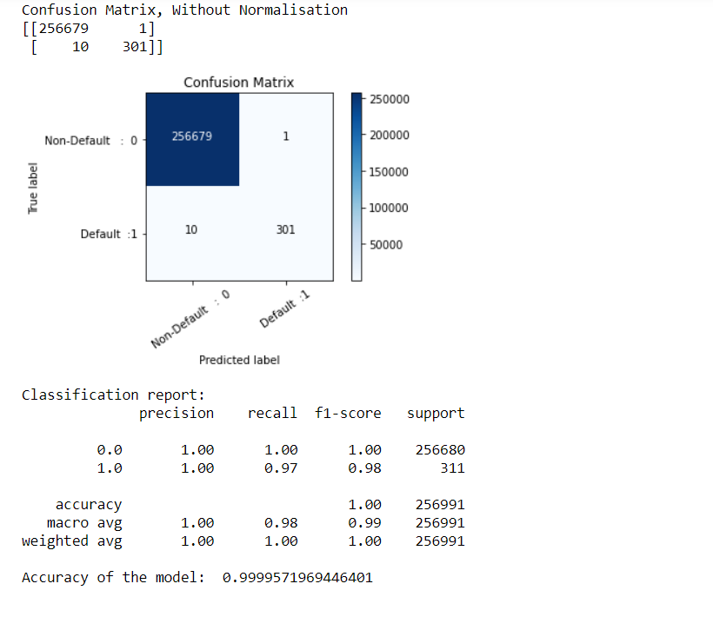
Tunning the Decision Tree model
After performing the GridSearchCV on Decision Tree Model , we found the best estimators mentioned above

Slide 26
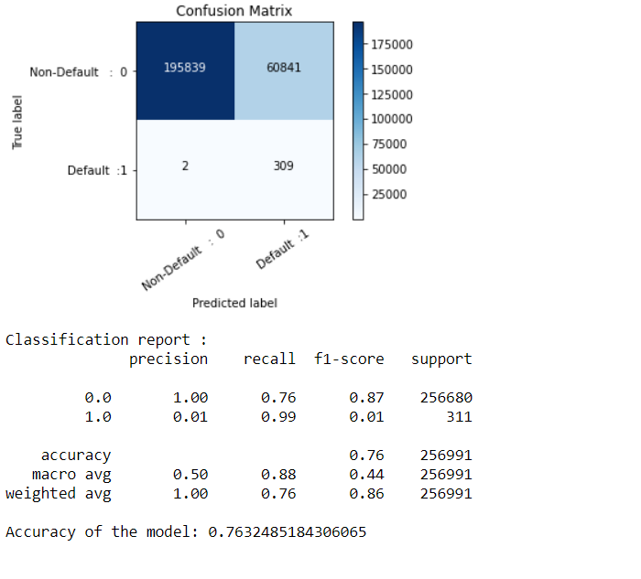
RandomForestClassifier
From the sklearn.ensemble library using the ‘RandomForestClassifier’ , we created a Random Forest model and following results were interpreted

Slide 27
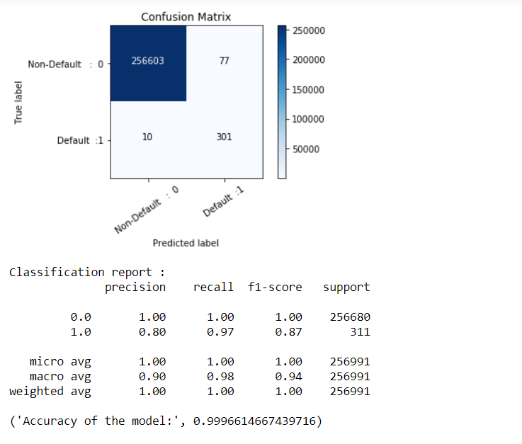
GradientBoostingClassifier
From the sklearn.ensemble library using the ‘GradientBoostingClassifier’ , we created a GradientBoosting model and following results were interpreted

Slide 28
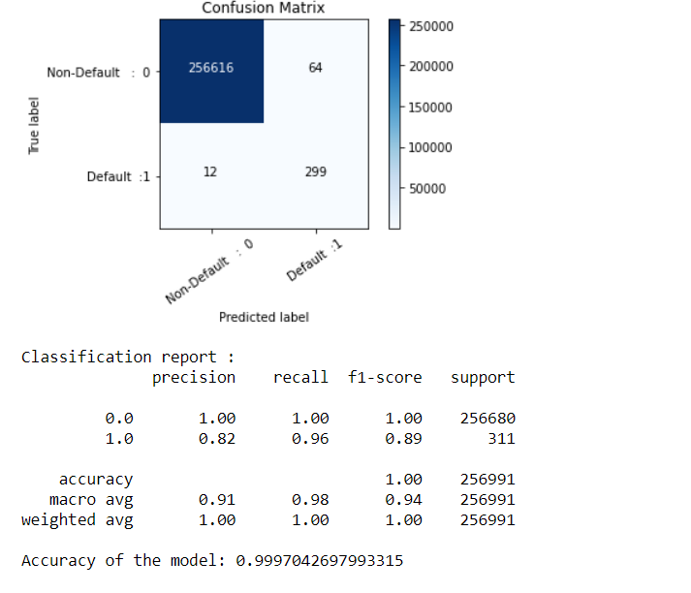
Neural Network
From the sklearn.neural_network library using the ‘MLPClassifier’ , we created a MLPClassifier model and following results were interpreted

Slide 29
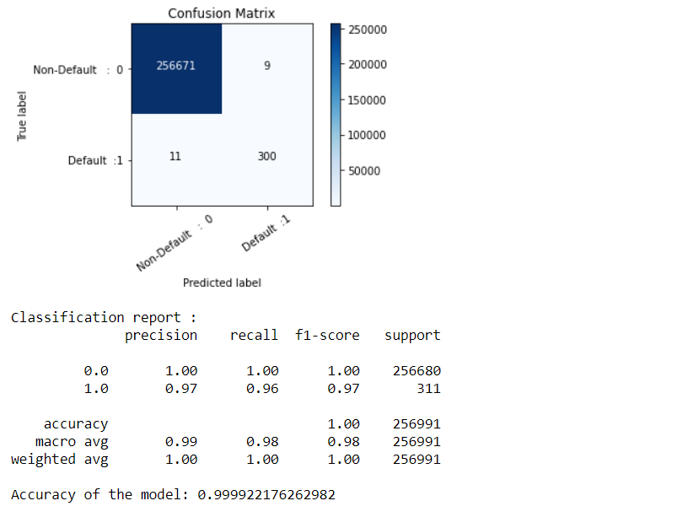
Tunning the MLPClassifier model
After performing the GridSearchCV on MLPClassifier Model , we found the best estimators mentioned above

Slide 30
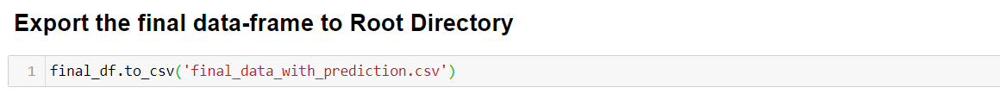
Final Model
Decision tree gave us very high Accuracy and very low Type 1 & Type 2 error. So, we chose Decision tree model for the entire data prediction.
Above code describes the prediction on the entire data set.
With the above code we have exported the predicted dataframe to root directory.

Slide 31
Conclusion:
With regards the XYZ Corp. Lending
By looking at the Statistics from the above models we can conclude that all these above models are good but we would go forward with the Decision Tree model when we compare it with other models.
The stats of the Decision tree model are the best than other models as it has less Type 1 & Type 2 errors and High F1 score & Accuracy.
Therefore, we will produce the Decision Tree model to XYZ Corp. to predict future defaults.

Slide 32
THANK YOU

